Slide 1
CHAPTER THREE The Topography of Ethiopia and The Horn
Objectives
Describe the topography of Ethiopia and the Horn.
Identify the physiographic divisions of Ethiopia.
Elucidate the physiographic characteristics of the Rift Valley.
Explain the impacts of relief on biophysical and socioeconomic conditions

Slide 2
General Characteristics of the Ethiopian Physiography
The Ethiopia’s topography is characterized by great diversity
flat-topped plateaus, high and rugged mountains, deep river gorges and vast plains
Altitude ranges from 125 meters below sea level (Kobar Sink) to 4620m amsl (Ras-Dashen).
Ethiopia has the largest proportion of elevated landmass in the African continent.
More than 50% of the Ethiopian landmass is above 1,000 meters of elevation; and above 1,500 meters makes 44% of the country.
Because of this, Ethiopia is said to be the “roof of eastern Africa.”

Slide 3
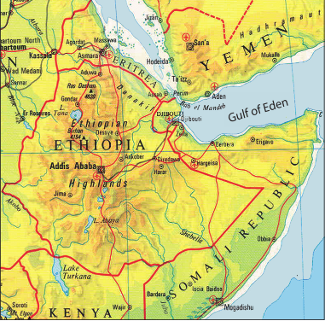
General Characteristics of the Ethiopian Physiography
Most of the Ethiopian Highlands are part of central and northern Ethiopia, and its northernmost portion extends into Eritrea.
the most significant physical features of the country, which form the largest continuous area of its elevation in the continent.
Dissected by rivers and deep gorges
Divided into several mountains and plateau that can be the source of many rivers
As a result, Ethiopian plateau is called “the water tower of north east Africa.”

Slide 4
General Characteristics of the Ethiopian Physiography
The diversity in topography is accompanied by differences in other natural features such as soil, climate, vegetation and wild life as well as socio-cultural and economic phenomena.
1000m is considered as a demarcation between highlands and lowlands
The cumulative effect of all this is that, the highlands have been significant throughout Ethiopian history in the economic, cultural and political life of the people.
These highlands make up nearly 56% of the area of the Ethiopia.
This is further subdivided into lower highland (1,000 - 2,000 m.a.s.l), which make up 35% and higher highland (>2,000 m.a.s.l) constituting nearly 22%.

Slide 5
Characteristics of Highlands vs Lowlands
highlands
lowlands
Moderate and high amount of rainfall (>600 mm per year).
Lower mean annual temperature (<20⁰C).
The climate is favorable for biotic life.
Rain-fed agriculture is possible.
Free from tropical diseases.
Attractive for human habitation and densely settled.
Fewer amounts of rainfall and higher temperature.
High prevalence of tropical diseases.
Lower population densities.
Nomadic and semi-nomadic economic life.
Vast plain lands favorable for irrigation agriculture along the lower river basins.

Slide 6
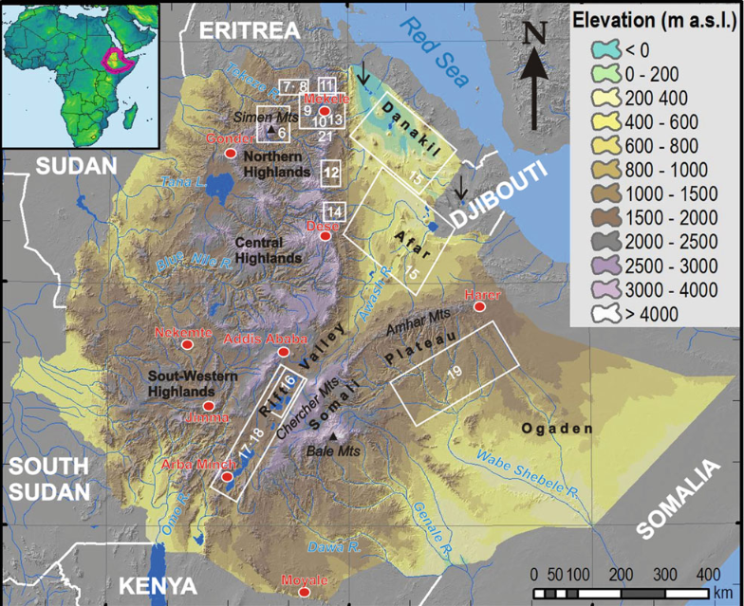
The Physiographic Divisions of Ethiopia
Following the structural divisions brought about by the geologic processes of the Cenozoic Era, three major physiographic units can be identified in Ethiopia. These are:
The Western highlands and lowlands
The South-eastern (Eastern) highlands and lowlands
The Rift Valley

Slide 7
The Western Highlands and Lowlands
Includes all the area west of the rift valley.
It extends from north to south encompassing nearly the whole western half of Ethiopia.
Makes up about 44% of the area of the country.
In the east the western escarpment of the rift valley bound it whereas westward, the land gradually descends in altitude until it merges into the western foothills and lowlands, along the sudan and south sudan border.
Further subdivided into four groups of highlands (76.3%) and four groups of lowlands (23.7%).

Slide 8
Western highlands
Western highlands
Tigray plateau
North central Massifs
The Shewa Plateau/central highlands
Southwestern highlands

Slide 9
A. Tigray plateau
Extends from the tekeze gorge in the south to central Eritrean highlands.
Separated from the Eritrean plateau by the Mereb river
Constitutes about 13% of the area of the region.
Elongated highland with most of the land being in between 1,000 and 2,000 meters above sea level.
The right bank tributaries of tekeze drain this plateau.
Long period of denudation has created residual features of granite hills, rugged topography, and Ambas.

Slide 10
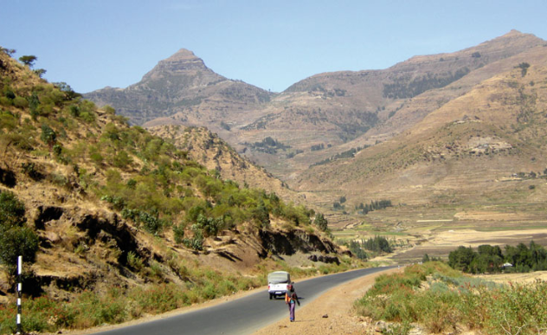
Continued
There are high mountains in this plateau with elevations of over 3000 meters, namely
Mount Tsibet (3988 m.a.s.l)
Mount Ambalage (3291 m.a.s.l), and
Mount Assimba (3248 m.a.s.l).
famous monastery at Debre-Damo, a tableland that can only be climbed by a rope pulley is located in this region
Mt Ambalage

Slide 11
B. North Central massifs
The largest in the western highlands.
Much of its northern and southern limit follows the abay and tekeze gorges.
The abay, tekeze and their tributaries have cut into this region a maze of gorges, steep sided river valleys, dividing the land into many isolated plateau blocks, precipitous tablelands and other rugged surface forms.
But much of these plateau and tablelands are still capped by the trappean lava.
In its central part, the physiographic unit also accommodates the lake tana basin surrounded by plains of fogera and dembia in the north and an upland plain in its south.

Slide 12
North… continued
58% percent of the region is at an altitude of more than 2,000 meters, making it, next to the Shewan Plateau, the second highest physiographic division.
The region consists of the Gonder, Wello and Gojjam Massifs.
Out of the 26 mountain peaks with altitude of more than 4,000m.a.s.l in Ethiopia, 19 mountain peaks are found in this physiographic region.
Among these, the most popular ones include
Mount Ras Dashen (4,620 m.a.s.l),
Mount Weynobar/Ancua (4462 m.a.s.l),
Mount KidisYared (4453 m.a.s.l), and
Mount Bwahit (4437 m.a.s.l) in the Simen Mountain System.
Mount Guna (4,231m.a.s.l) in the Debre Tabour Mountain System,
Abune Yoseph (4,260 m.a.s.l) in the Lasta highlands of Wello and
Mount Birhan (4,154 m.a.s.l) in the Choke Mountain System

Slide 13
North… Continued
The Mountain systems in Gonder and Gojjam are separated from the eastern group of mountains in Wello by impenetrable and deep gorges.
At one point though, they are connected by Yeju-Wadla Delanta land bridge (ridge).
This land bridge has been significant in history.
served as a route of penetration by the Turks, Portuguese, and Italians etc.
The Woreta-Debre Tabor-Woldya road constructed to link the northwestern region with Asseb through Woldya and Dessie took advantage of this land bridge.

Slide 14
C. The Shewa Plateau/central highlands
Bounded by the rift valley in the east and southeast, by the abay gorge in its northern and western limit, and the omo gorge in the south and west.
Occupies a central geographical position in Ethiopia.
With only 11% of the area of the whole physiographic region, the shewa plateau is the smallest of the western highlands. Nearly three fourth of its area is at an altitude of more than 2,000 meters above sea level.
It has, therefore, the largest proportion of elevated ground.

Slide 15
C. Shewan…. continued
Drained outward in all directions by the tributaries of Abbay, Omo and Awash
It, therefore, forms a water divide for these three river basins.
The tributaries of Abay
Guder,
Muger,
Jema etc.
Omo and Awash have dissected the other sides of the plateau.
The highest mountain in the Shewan plateau is
Mount Abuye-Meda (4,000 m.a.s.l) in Northern Shewa,
Mount Guraghe in the south is 3,721 meters high.

Slide 16
D. The Southwestern Highlands
Consists of the highlands of wellega, illuababora, jimma, kaffa, gamo and gofa.
Separated from the adjacent highlands by the abay and omo river valleys.
Extends from the abay gorge in the north to the kenya border and chew bahir in the south.
Accounts for 22.7% of the area of the region.
Is the second largest in the western highlands.
About 70% of its area is lies within 1,000-2,000 meters altitude.

Slide 17
D. South… continued
The southwestern plateau is the wettest in Ethiopia.
It is drained by
Dabus
Deddessa (tributaries of Abay),
Baro,
Akobo and the Ghibe/Omo rivers.
The numerous streams have cut these highlands to produce the most dissected and rugged terrain that accommodates the most numerous and diverse ethnic linguistic groups in Ethiopia.
With a height of 4,200 meters above sea level, Guge Mountain is the highest peak in this physiographic subdivision.

Slide 18
The Western Lowlands
Western foothills and border plains that extend from western tigray in the north to southern gamo-gofa in the south.
In certain places, edges or part of the highlands protrude into the lowlands, interrupting their continuity.
They make 11% of the area of the physiographic region.
The general elevation ranges between 500 and 1000 meters above sea level.

Slide 19
Continued
Western lowlands
Tekezze lowlands
Abay-Dinder lowlands
Baro-Akobo lowlands
Ghibe lowlands
It can be subdivided into four categories

Slide 20
Continued
With the exception of the Baro lowland, the region is generally characterized by arid or semi-arid conditions.
Pastoral or semi-pastoral economic activities dominate the area.
As one moves northwards, the degree of aridity increases, making rain-fed agriculture more difficult.
Since one or two rivers cross all of these lowlands, irrigation agriculture is highly feasible.
For example, the Baro lowland has an extensive flat area suitable for mechanized agriculture.

Slide 21
Cont.…
The Ghibe/Omo lowland, which includes the lower Ghibe/Omo Valley and the northern section of the Turkana basin, is classified in the Western lowlands from its geographical location.
But structurally it also belongs to the Rift Valley.
It is an area, which is both faulted and tectonically depressed.
In the Western lowlands, there are small but important towns.
Their importance could be related to agriculture, history, or are simply border towns and frontier ports.
These are Humera, Metema, Omedla, Kurmuk, Gambella etc.

Slide 22
The Southeastern Highlands and Lowlands
South east highlands
Arsi- Bale-Sidama
Hararghe Plateau
South eastern Lowlands
Ogaden
Elkerie
Borena

Slide 23
A. Arsi-Bale-Sidama Highlands
The second largest in terms of area.
Accounts for 37% of the area of Ethiopia.
The highlands make up 46% of the physiographic division while the rest is lowland.
The eastern escarpment of the rift valley makes the western and northern limit.
Further subdivided into
Two units of highlands and
Two units of extensive lowlands.

Slide 24
Continued…
Are found to the east of the lakes region.
Make up 28.5% of the area of the region and 62% of the south - eastern highlands.
The arsi highlands are made up of flat rolling uplands and dissected mountains.
The well-known mountains in this area are
Mount kaka (4,180 m.A.S.L),
Mount bada (4,139 m.A.S.L) and
Mount chilalo (4,036 m.A.S.L).

Slide 25
Continued…
The Bale highlands are separated from the Arsi highlands by the head and main stream of Wabishebelle.
They consist of a platform looking basaltic plateau in the north-central part and high mountain massif to the south.
The Afro-Alpine summit of Senetti plateau is found on the latter group.
The highest mountain peaks in this region are Tulu-Dimtu (4,377 m.a.s.l) and Mount Batu (4,307 m.a.s.l).
The Arsi-Bale Highlands are important grains producing areas with still high potential.

Slide 26
Cont.….
The Sidama Highlands are separated from the Bale Highlands by the Ghenale river valley.
occupy the southwestern corner of this region.
The prominent feature here is the Jemjem plateau, an important coffee growing area.
Rivers Wabishebelle and Ghenale along with their tributaries have dissected this physiographic region.
Specially, Weyb River, tributary of Ghenale, has cut an underground passage (Sof Omar cave) through the Mesozoic Limestone rocks.
The cave is found near Bale Mountains.
It is one of the World's most spectacular and extensive underground caverns creating a magnificent view accessible only by an underground stream.

Slide 27
The Hararghe Plateau
Is a north-easterly extension of the south-eastern highlands.
It extends from the chercher highlands in the south-west to jigjiga in the east.
It makes up 38% of the south eastern highlands and 17.4% of the whole physiographic region.
It has the smallest proportion of upper highland (>2,000 meters).
It is a low lying and elongated region.

Slide 28
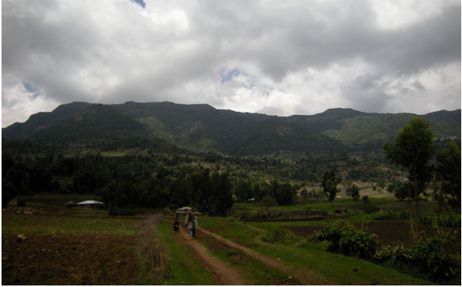
Hararghean plateau
Rising sharply from the Rift Valley floor, it immediately but gently descends east and southeastward.
The left-bank tributaries of Wabishebelle drain it.
Much of the Trappean lava is removed and the Mesozoic rocks are extensively exposed.
The highest mountain here is Mount Gara-Muleta (3,381 m.a.s.l).

Slide 29
The Southeastern Lowlands
Located in the southeastern part of the country and they are the most extensive lowlands in Ethiopia.
Make up 54% of the area of the physiographic region and around one-fifth of the country.
Divided into Wabishebelle plain (60%) and the Ghenale plain (40%).
Include the plains of ogaden, elkere, and borena. Southeastward sloping plains characterize these lowlands.
These extensive plains are interrupted here and there, by low hills, low ridges, inselbergs and by shallow and broad river valleys and depressions.

Slide 30
Cont.….
Because of the harsh climatic conditions, these lowlands are little used and support very small population.
They are sparsely inhabited by pastoral and semi-pastoral communities.
The economic potential for this region includes animal husbandry, irrigation, agriculture and perhaps exploitation of petroleum and natural gas.

Slide 31
The Rift Valley
The Rift Valley is a tectonically formed structural depression.
The formation of the Rift Valley has separated the Ethiopian Highlands and Lowlands in to two.
It extends from the Afar triangle in the north to Chew Bahir for about 1,700 km.
It covers 18% of the area of Ethiopia.
It is elongated and funnel shaped, with a NE-SW orientation.
It opens out in the Afar Triangle, where it is the widest, and narrows down to the south.

Slide 32
Cont.….
The floor of the Rift Valley is made up of interconnected troughs, grabens and depressions.
Volcanic rocks, fluvial and lacustrine deposits cover the floor.
In many places, numerous volcanic domes, hills and cinder cones rise from the floor.
Altitude in the floor ranges from 125 meters below sea level at Dallol Depression, to as high as 2,000 meters above sea level in the Lakes region.
The bounding escarpments are also of varying heights.
From the floor to the edge of the escarpment, the heights vary from 200 to 1500 meters.
Because of its altitudinal variation and positional differences, the climate also varies from warm, hot and dry to cool and moderately moist conditions.

Slide 33
Cont.…
Similarly, the social and economic life reflects this pattern.
There are places, which are desolate and sparsely inhabited by pastoralists where as in others parts people practice some rain-fed agriculture.
The Rift Valley is further subdivided into three physiographic sub-regions.
the Afar Triangle,
the Main Ethiopian Rift, and
the Chew Bahir Rift

Slide 34
Afar Triangle
The Afar Triangle is the largest and widest part of the Rift Valley. It makes up 54% of the Rift Valley area.
The area is generally of low altitude (300-700 meters).
Where elevation drops from approximately 1,000 meters in the southwest to below sea level in the north (Danakil depression) at around 125 meters below sea level.
The depression, maximum temperatures can exceed 50°C during the summer wet season

Slide 35
Cont.…
It is characterized by
Faulted depressions (grabens), volcanic hills, active volcanoes, volcanic ridges, lava fields and low lava platforms
Lakes (abe, asale, and afrera)
Denakil depression (kobar sink).
Salt plain
Hot and dry climate
The economic importance of this region includes salt extraction, irrigation along the awash river and electric potential from geothermal energy.

Slide 36
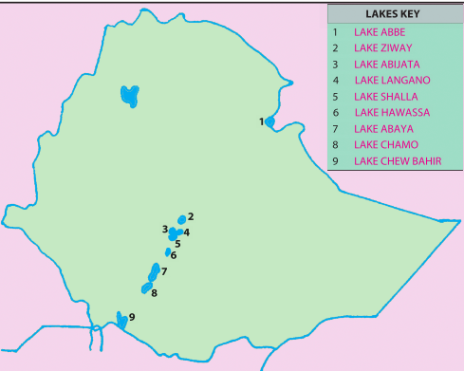
The Main Ethiopian Rift/Central Rift
It refers to the narrow belt of the rift valley that extends from awash river in the north to lake chamo in the south.
With the exception of the Arba-minch area, the bounding escarpments are generally low.
This part of the rift valley is the narrowest and the highest.
It has an average width of 50-80 kilometers and general elevation of 1,000-2,000 meters above sea level.

Slide 37
Cont.….
It is characterized by
Cinder cones and volcanic mountains e.g. Mount Fentale, Boseti-guda (near Adama), Aletu (north of Lake Ziway) and Chebi (north of Lake Hawasa).
Numerous lakes formed on tectonic sags and fault depressions.
It is mild and wet
People practices rain-fed agriculture, recreational value of the lakes, the agricultural importance of some streams and lakes, and the geothermal energy potential.

Slide 38
The Chew Bahir Rift
This is the smallest and the southern-most part of the rift valley.
Gneissic highlands of konso and the surrounding highlands separate it from the main Ethiopian rift to the north.
It is characterized by
Broad and shallow depression,
Marshy area covered by tall grass, into which the segen and woito streams empty.

Slide 39
The Impacts of Relief on Biophysical and Socioeconomic Conditions
Agricultural practices
Crop production
as some corps are well adapted to higher altitudes (barley, wheat) and others to low altitude (sorghum, maize).
The practice of animal husbandry
most equines(horses) and sheep are reared in the higher altitudes and camels and goat are well adapted to lower altitudes

Slide 40
Cont.…
Settlement pattern
Highlands of Ethiopia that experience a temperate type of climatic condition that are mainly free from most of the tropical diseases are densely settled.
Rugged and difficult terrain hinders the development of settlement and its expansion.
The highlands of Ethiopia are characterized by sedentary life and permanent settlements while lowlands that are inhabited by pastoralists have temporary settlements.

Slide 41
Cont.….
Transportation and communication
The highly dissected nature of the landscape is a barrier to the development of internal surface transportation that resulted in the long-term isolation of many communities
The difficult terrain makes infrastructure development and maintenance costly.
TV and radio communications are also highly influenced by relief.
The rugged topography rendered rivers less navigable due to the waterfalls, deep gorges and steep cliffs.

Slide 42
Cont.…
Hydroelectric power potential
The great difference in altitude coupled with high rainfall created suitable conditions for a very high potential for the production of hydroelectric power in Ethiopia.
Socio-cultural feeling
The rugged terrain as a result of excessive surface dissection resulted in the long-term isolation of communities that led to the occurrence of cultural diversity.
People who live in the highlands have been identifying themselves as degegnas (mountaineers) and those who live in the lowlands as kollegnas (lowlanders).

Slide 43
Cont.….
Impacts on climate
The climate of Ethiopia is a result of the tropical position of the country and the great altitudinal variation of the general topography.
Highlands with higher amount of rainfall and lower rate of evapo-transpiration tend to be moisture surplus compared to the moisture deficit lowlands.
Impacts on soil
Steep mountain slopes provide low angle of rest, unstable surface materials and subject to degradation processes and relatively form shallow and little developed soils.
Impacts on natural vegetation
Relief through its effect on climate and hydrology affect the type of natural vegetation grown in an area

